Slide 1
Navigation Meshes
Parthfinding
NavMeshes
Programming – AI for Games
Last modified 09/02/16 by Sam Cartwright

Slide 2
Contents
A* Recap
A* Improvements
Pathfinding Graphs
Navigation Meshes
Steering

Slide 3
Pathfinding
Pathfinding is a search method for finding a path between location A to B
A* (A Star) is perhaps the most well known pathfinding method used in games development
Finds an acceptable path to a target, not necessarily the most optimal path

Slide 4
A* Recap
List open : start
List closed
While open not empty
cur = optimal open node
if cur == end break
add cur to closed
for each cur neighbour
if neighbour not in closed
if neighbour not in open
add to open
neighbour previous = cur
else
update cost and previous if needed
A simple A* implementation
The final path could be the list of previous nodes starting from end

Slide 5
A* Improvements – Theta*
There are various methods to improve A*
Theta* is a technique that allows for path smoothing while searching for a path
Rather than smoothing once a path has been found
Performs Line-of-Sight checks as it searches to cut unneeded nodes
Another improvement, Lazy Theta*, stores “clear path angles” through each node to help “skip” nodes
Each node contains additional values to specify the angles around the node that lead to its neighbour nodes without any obstacle in the way
When searching we can test if the angle between the previous node and current+1 is within the “safe” angles specified by node current
If it is then we form a path between previous and current+1 and skip current all together

Slide 6
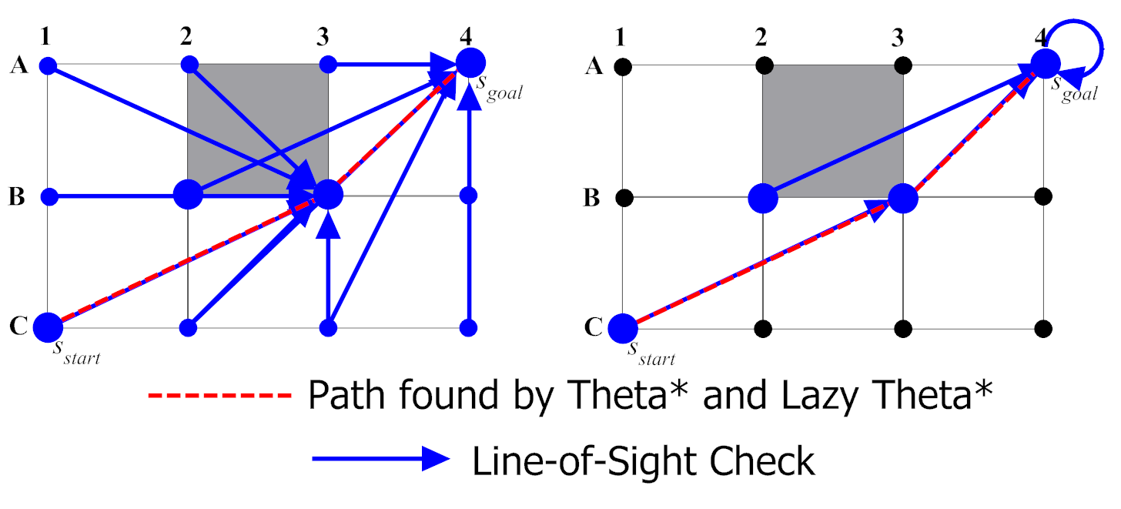
Theta* and Lazy Theta*

Slide 7
A* Improvements – Jump Point Search
Jump Point Search (JPS) is another grid-based technique
Uses A* but prunes the graph of nodes by determining choke points
Nodes at choke points in the grid are determined that have clear line-of-sight to nearby nodes
We path through these choke points rather than through each grid cell

Slide 8
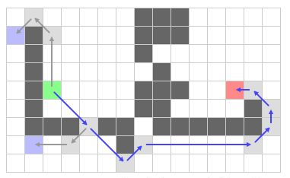
A* Improvements – Jump Point Search

Slide 9
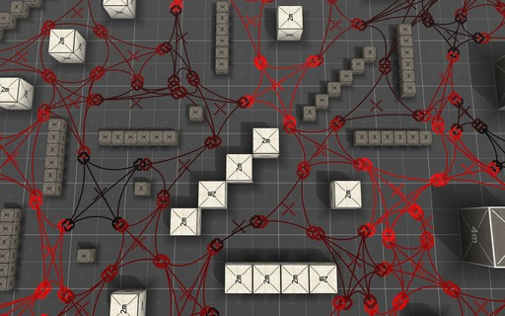
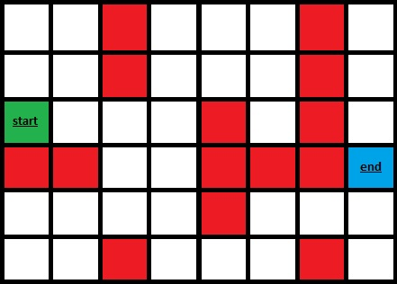
Pathfinding Graphs
Graph type goes a long way in helping optimise a path
2D/3D Grid
Quite easy to set up, and works well for tile based games
3D grids can be extremely memory intensive
Node Graph
Made up of nodes that are connected through edges
Each node has a location on the map, and is connected to other nodes
Much more efficient than a grid
Navigation Meshes (NavMeshes)
Similar to a Node Graph, NavMeshes work by using polygons to specify nodes
Edges shared between two polygons count as a connection between nodes
NavMeshes can either be built from existing terrain data, or specially created to fit the areas the AI can go

Slide 10
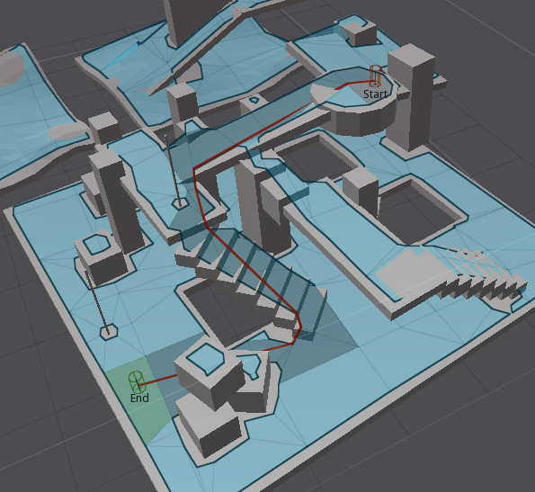
Navigation Meshes
Artists typically craft NavMesh meshes
Algorithms can be written to analyse a scene and craft a NavMesh that avoids obstacles
Properties can be specified to avoid a radius around obstacles based on the radius of Agent collision volumes
When pathing, Agents sometimes don’t need to perform collision checks
If the Agent sticks to the NavMesh then it should be guaranteed to avoid walls and obstacles

Slide 11
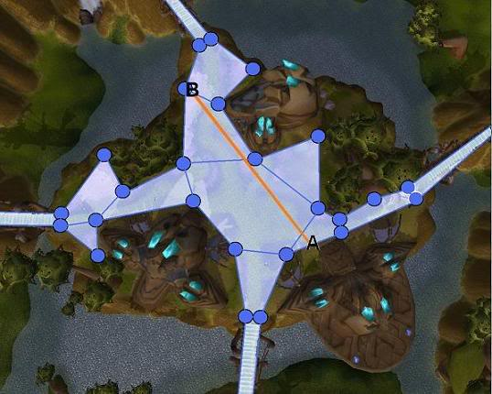
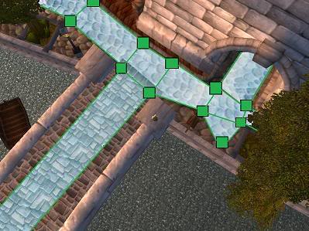
Navigation Meshes
A Naïve approach to navigating a NavMesh would be
Path between the center of each NavMesh node
However the strength of a NavMesh is that a node specifies a large “safe” area that the Agent can stand in
If the Agent wanted to path to a location within the same node that it is standing in then no pathfinding is needed

Slide 12
Navigation Meshes
Paths between nodes can also be smoothed
We could just path via the mid-point of an edge
But this would create zig-zag paths
The correct method is to smooth our path after we have calculated the nodes to path through
We determine if we can path through an edge towards our goal and at what point we intersect the edge

Slide 13
Navigation Meshes

Slide 14
Navigation Meshes

Slide 15
Navigation Meshes

Slide 16
Navigation Meshes

Slide 17
Navigation Meshes

Slide 18
Navigation Meshes

Slide 19
Steering
Combining Steering Behaviours improves the look of our Agents as they navigate the path
We make use of Seek and Arrival behaviours
Our Agent Seeks to each waypoint in its Path
The Agent Arrives at the final waypoint in the Path

Slide 20
Summary
A* is still the most common pathfinding technique in game development
Improvements exist but work off the existing idea of A*
Graphs can be represented in many ways
Dependant on game genre
NavMeshes allow for use to greatly reduce the number of graph nodes needed by having nodes represent large polygonal areas
Usually Convex polygons only

Slide 21
References
Witmer, N. 2016. Jump Point Search Explained. [ONLINE] Available at: http://zerowidth.com/2013/05/05/jump-point-search-explained.html. [Accessed 09 February 2016].
Ian Millington, 2009. Artificial Intelligence for Games. 2 Edition. CRC Press.

